Slide 1

PRODUCTION TECHNOLOGY (MEC-303A)
B.Tech. 5th Semester
Unit-1 (b)
Dr. Mukesh Kumar
Assistant Professor (Guest Faculty)
Mechanical Engineering Department

Slide 2
Machining Processes and Machine Tools
Machining is the removal of material and modification of the surfaces of a workpiece
Machining involves secondary and finishing operations

Slide 3
Machining Processes and Machine Tools
Copyright © 2010 Pearson Education South Asia Pte Ltd
Major types of material removal processes:
Cutting
Abrasive processes
Advanced machining processes
Machining operations is a system consisting of the
Workpiece
Cutting tool
Machine tool
Production personnel

Slide 4
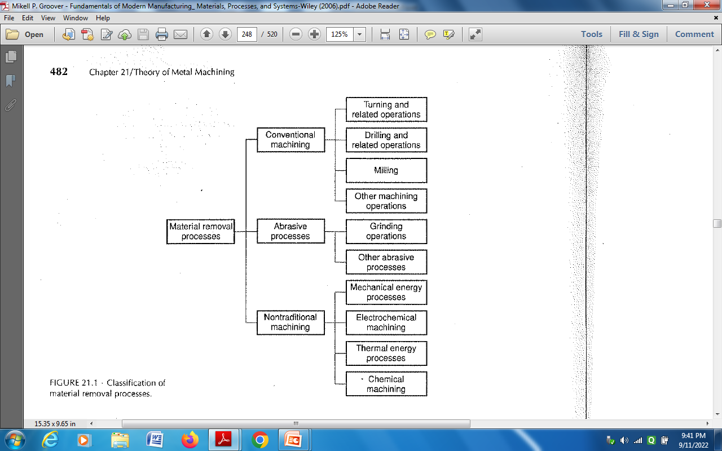
Classification of material removal process

Slide 5

Types of Machining Operation
Cutting processes remove material from the surface of a workpiece by producing chips
Common cutting processes:
Turning (workpiece rotates;
tool moves left, removes
layer of material)
Cutting off (cutting tool moves radially inward)
Slab milling
(rotating cutting tool
removes material
from workpiece)
End milling (rotating
cutter; produces cavity)
Copyright © 2010 Pearson Education South Asia Pte Ltd

Slide 6
Types of Machining Operation
Copyright © 2010 Pearson Education South Asia Pte Ltd
In the turning process, the cutting tool is set at a certain depth of cut [mm] and travels to the left (with a certain velocity) as the workpiece rotates
Feed, or feed rate, is the distance the tool travels horizontally per unit revolution of the workpiece [mm/rev]
  This tool movement
  produces chips,
  which move up the face
  of the tool

Slide 7
Theory of Chip Formation in Metal Cutting
Idealized model; Orthogonal; 2-D cutting with a well-defined shear plane; also called M.E. Merchant model
Orthogonal (2-D) cutting without a well-defined shear plane: “shear zone”; why rough surface?
Copyright © 2010 Pearson Education South Asia Pte Ltd
In idealized model, a cutting tool moves to the left along the workpiece at a constant velocity, V, and a depth of cut, t_{o}
Chip thickness, t_{c}

